Slide 1

Machine learning for a 5G future
Presented by:
Nadira Islam
IT – 17051

Slide 2
Before discussing “Machine Learning for 5G Future”, we will learn about 5G Network and Machine Learning ?

Slide 3
WHAT IS 5G? 5G is the 5th generation of mobile networks, a significant evolution of todays 4G LTE networks. 5G has been designed to meet the very large growth in data and connectivity of today’s modern society, the internet of things with billions of connected devices, and tomorrow’s innovations. 5G will initially operate in conjunction with existing 4G networks before evolving to fully standalone networks in subsequent releases and coverage expansions In addition to delivering faster connections and greater capacity, a very important advantage of 5G is the fast response time referred to as latency. Latency is the time taken for devices to respond to each other over the wireless network. 3G networks had a typical response time of 100 milliseconds, 4G is around 30 milliseconds and 5G will be as low as 1 millisecond. This is virtually instantaneous opening up a new world of connected applications.

Slide 4
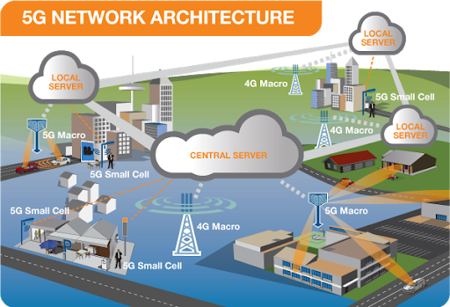

Slide 5
5G Network Security :
The 3GPP(3rd Generation Partnership Project ) Technical Specifications Group Services & Systems Aspects (TSG SA3) in its Release 14 highlighted the 17 key threat / areas and possible solutions for security architecture of 5G networks. The security architecture, procedures and requirements for 5G systems were then formulated in Release 15 (R15) in June 2019 [4]. The R15 includes security standards for standalone and non-standalone Enhanced Mobile Broadband scenarios, whereas, upcoming R16 and R17 will be focusing on security standards for massive Machine Type Communication and Ultra Reliable Low Latency Communications. The new security features aims to provide E2E security along with flexibility of incorporating multiple authentication frameworks, and higherlayer security protocols to support security for Service Based Architecture (SBA) in 5G. The SBA and network slicing in 5G networks allows higher modularity in the design measure of security protocols. The E2E security architecture can be segregated into two groups. The first one named Network Access Security defines procedure and requirements of securely connecting end-device to radio access network. These procedures secure the device connectivity from end device and edge/RAN domains threats . From hereon, ensuring protection of data and privacy from access network to core network and beyond can be referred as Network Domain Security. Highly software-centric and dynamic 5G network architecture where user data is traversing through several network slices and layers, also require agile, adaptive and robust security management and automation

Slide 6
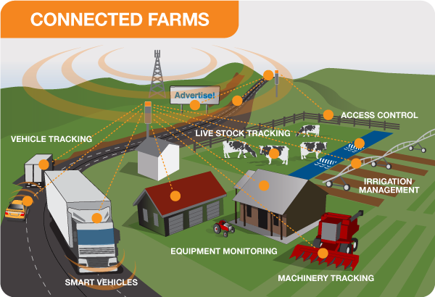
5G will keep us connected in tomorrow’s smart cities, smart homes and smart schools, and enable opportunities that we haven’t even thought of yet.

Slide 7
What is Machine learning? Machine learning is an application of artificial intelligence (AI) that provides systems the ability to automatically learn and improve from experience without being explicitly programmed. Machine learning focuses on the development of computer programs that can access data and use it learn for themselves. The process of learning begins with observations or data, such as examples, direct experience, or instruction, in order to look for patterns in data and make better decisions in the future based on the examples that we provide. The primary aim is to allow the computers learn automatically without human intervention or assistance and adjust actions accordingly.

Slide 8
Types of Machine Learning : Basically, algorithms play an important role in Machine Learning: On the one hand, they are responsible for recognizing patterns and on the other hand, they can generate solutions. Algorithms can be divided into different categories:
Supervised learning : In the course of monitored learning, The aim is to train the system in the context of successive calculations with different inputs and outputs and to establish connections.
Unsupervised learning : In unsupervised learning, artificial intelligence learns without predefined target values and without rewards. It is mainly used for learning segmentation .
Partially supervised learning : Partially supervised learning is a combination of supervised and unsupervised learning.
Encouraging learning : The algorithm is taught by a positive or negative interaction which reaction to a certain situation should take place.
Active learning: Within the framework of active learning, an algorithm is given the opportunity to query results for specific input data on the basis of pre-defined questions that are considered significant.

Slide 9
The Commercial Applications of Machine Learning: Machine Learning is a key technology in the development of autonomous systems: In addition to driverless cars, Machine Learning is also used in collaborative robots. Other areas of application for Machine Learning would be:
Analysis of the stock market
Credit Card Fraud Detection
Automated diagnostic procedures
Acquisition of landmines in acoustic sensor and radar data
With the help of Machine Learning, economic data can be turned into money. Companies that rely on Machine Learning or Machine Learning methods are not only able to increase the satisfaction of their customers, but also to achieve cost reductions at the same time. Through Machine Learning, customer wishes and needs can be evaluated

Slide 10
Most Popular Applications Of Machine Learning : Machine Learning is applied at Netflix and Amazon as well as for Facebook's face recognition. Another application of Machine Learning that is now firmly integrated into everyday life is the automatic detection of spam that is integrated into almost all e-mail programs. Within the scope of spam detection, the data contained in the e-mails is analysed and categorised. Other areas of application for Machine Learning include search engine ranking, combating cybercrime and preventing computer attacks.

Slide 11
Now we will talk about the main topic of the presentation “Machine Learning for 5G Future “.

Slide 12
Machine learning shows promise to assist smarter use of network-generated data, enabling ICT network operators and service providers to adapt to changes in traffic patterns, security risks and user behavior . An increased bandwidth, higher spectrum utilization and high data rates in 5G networks have also widen the threat and privacy landscape from personal device to the service provider network. Thus, the network should be smart enough to deal with these challenges in realtime and ML techniques could help model these robust dynamic algorithms that can help to detect network issues and provide with the possible solution in real-time. In the same way, ML(Machine Learning) protect the personal devices that are connected to the internet by providing adaptive security solutions that can tackle diverse network situations, threats, and attacks.

Slide 13
In short to medium term plan, ML(Machine Learning) can be used to detect the threats and counter them with the robust and adaptive security algorithms. Whereas, in the long-term, a fully automated security mechanism is envisioned for timely response to threats and attacks.The 5G networks are expected to support much higher level heterogeneity (in terms of connected devices and networks) as compared to its predecessors. For instance, 5G networks support smart vehicles, smart homes, smart buildings and smart cities. Similarly, the Internet of Things (IoT) in 5G network structure will involve more robust and adaptive techniques to handle the critical security issues both at the network and device sides. The security of such networks will be much more complicated because of the outside intrusion as well as the local intrusion.

Slide 14
ML can provide solutions by classifying fragile security links in-between, for instance, identity, authentication, and assurance. The security and privacy in 5G-IoT will cover all the layers such as identity protection, privacy, and E2E protection. For instance, the key authentication framework from end-device to core network and on-ward to service provider, while concealing the key identifier is still a complex issue. We believe ML can also play an important role in key authentication along with effectively minimizing the masquerading attacks.Catering for security and privacy of data from these different systems with uniquely different security requirements become a tedious task. Powerful ML with overview of SBA and security requirements for different end-systems can detect and rectify these issues in real-time by classifying and clustering unusual threats.

Slide 15
This, in turn, greatly assist the workforce skills shortage in information security industry. ML can help in developing security mechanisms by creating trust models, device security and data assurance to provide systematic security for the whole 5G-IoT network.

Slide 16
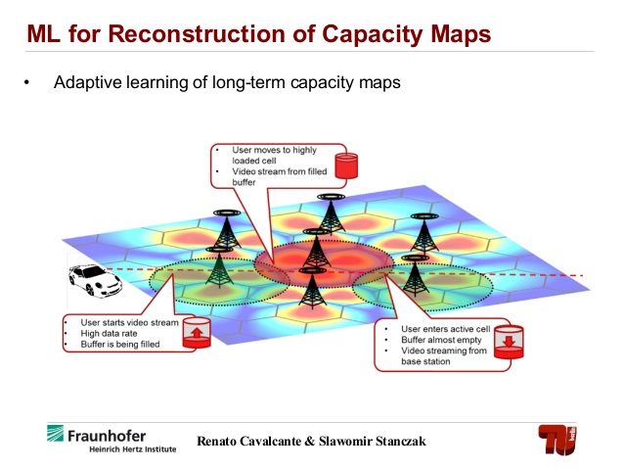
Machine Learning For 5G Future

Slide 17
Thank You

